Slide 1

“Application for Grocery Delivery”
TASK - 1

Slide 2
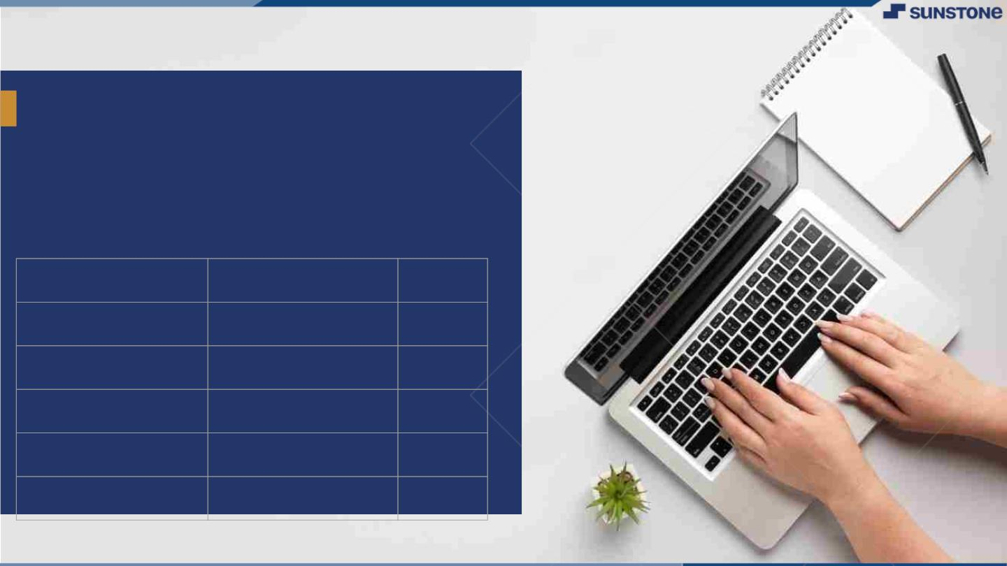
Application for Grocery Delivery
The purpose of this document is to provide a comprehensive overview of the system requirements for the Grocery Delivery Application.
This application aims to facilitate the online ordering and delivery of groceries to customers.
LMS Username
Name
Batch

Slide 3
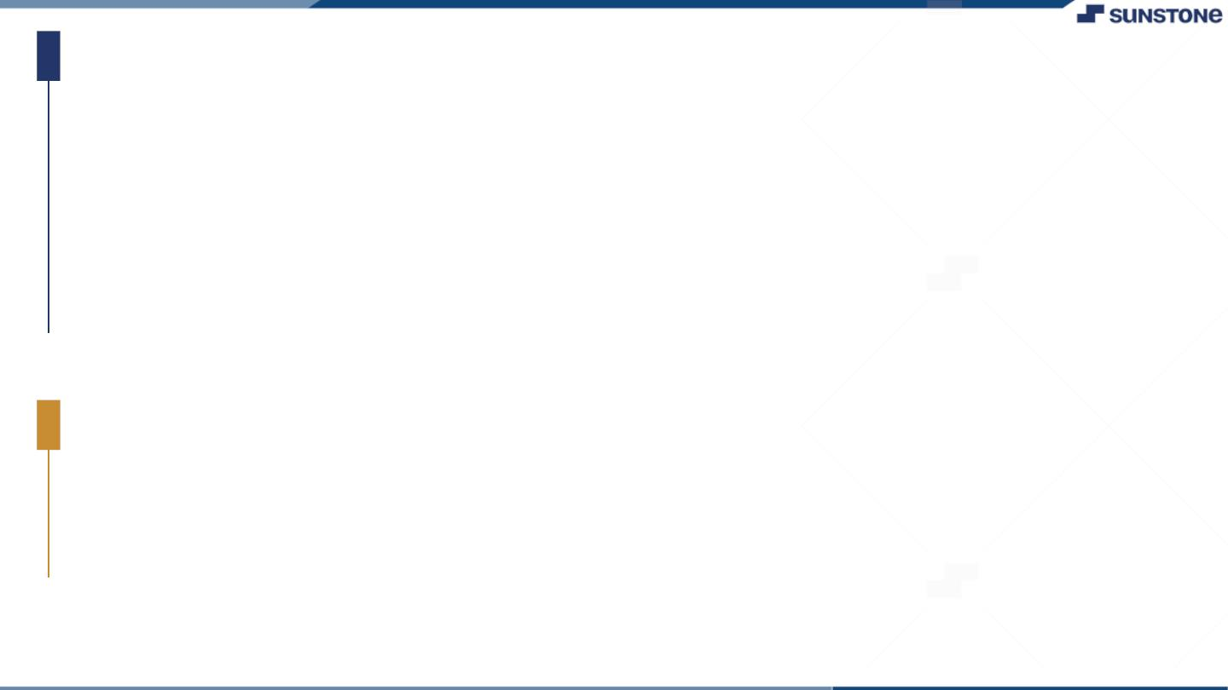
Task-1
Creation of SRS & Github
▪
▪
▪
Create SRS: “Application for grocery delivery”
Creation & Set-up of Github account
Creation & Hands-on to various commands of Git Bash
Evaluation Metric:
● 100% Completion of the above tasks
Learning Outcome
▪
▪
▪
▪
Get to know about different lifecycle models.
Understanding importance and how to create an SRS
Knowing various commands of Github
Understanding agile and scrum management techniques for efficient product development

Slide 4

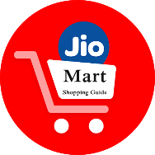
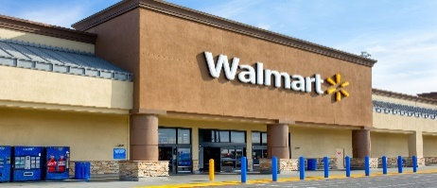
Introduction:
The primary objective of the [Name of Grocery Delivery Project] is to provide an innovative and seamless grocery shopping experience for residents in our community. We aim to address several key challenges, including Convenience, Accessibility

Slide 5
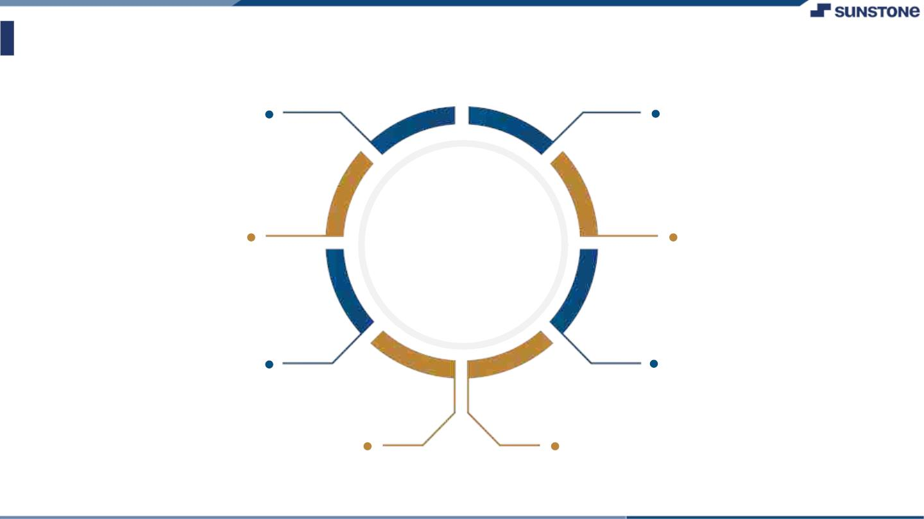
Assessment Parameter
Gather requirements for the project
Add Readme.md file with
Description of the project
Prepare database design schemas
Check-List
Commit all changes with "first
commit"
Get your initial project
Structure ready
Create a repository on github
Realted to project
Initiate a git repository
Push your changes to github

Slide 6
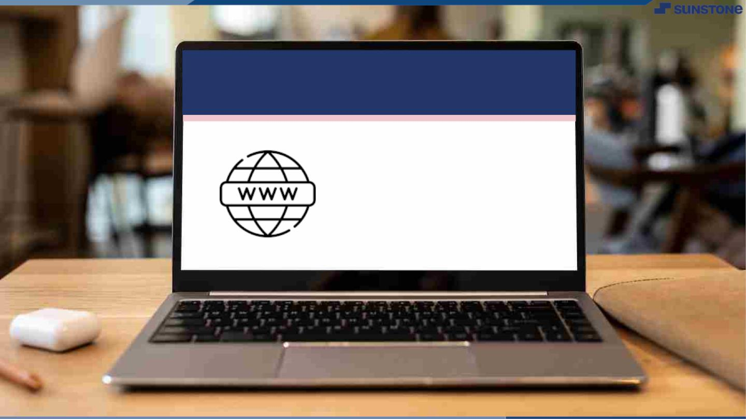
Submission Github
https://github.com/1511Harirajan/NM-APEC-IT-GROUP5

Slide 7


